Slide 1
DEX: The Origins
Sohum Mehrotra, Jun Lee, and Jae Rim Choi

Slide 2

What is this game about?
Story Bases
A.I robot in a post-apocalyptic world trying to keep the hoard of creatures at bay by keeping his base powered on.
2D Platformer
Two player co-op game focusing team play and timing.

Slide 3
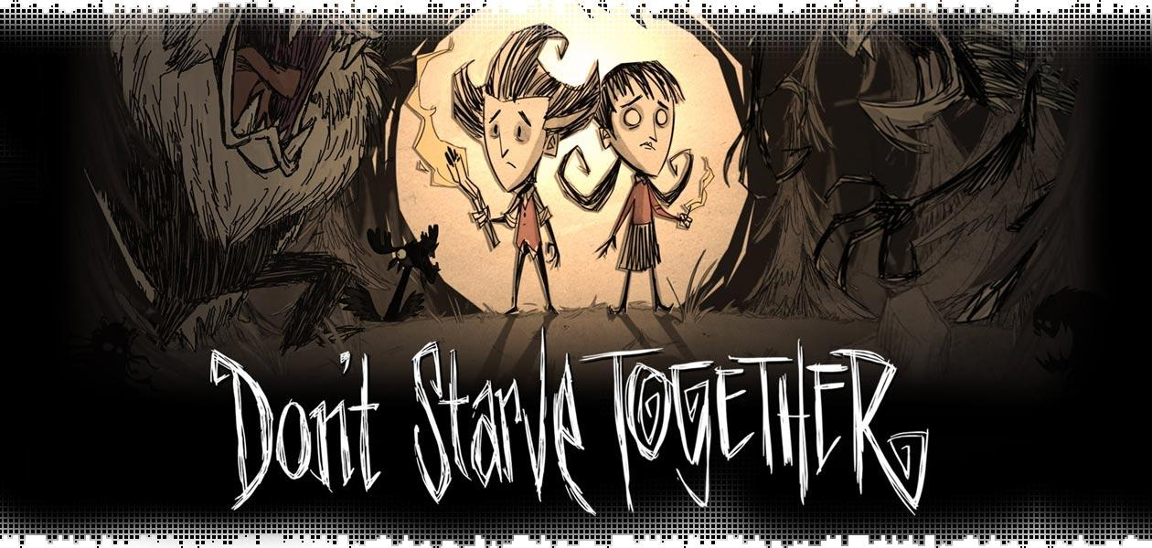
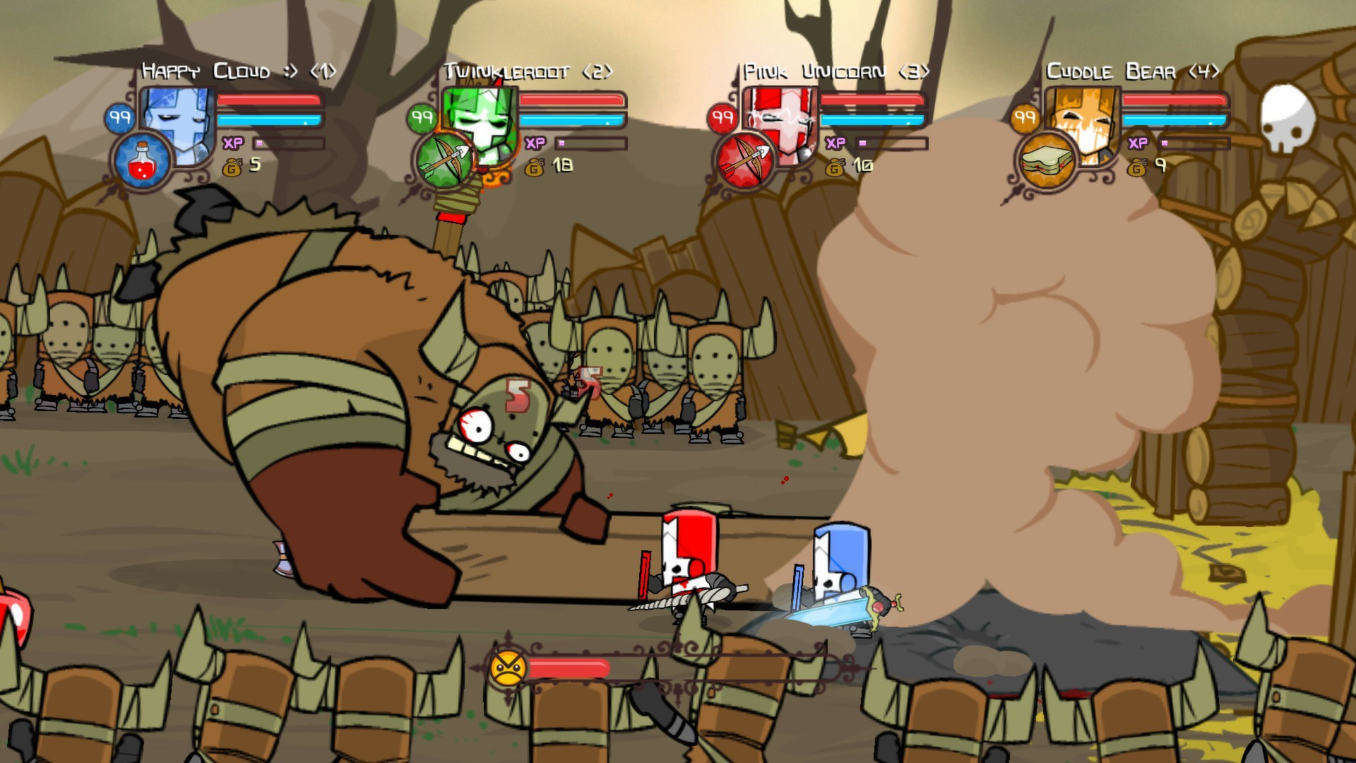
what will it be like?
castle crashers by The Behemoth
Don’t Starve Together by Klei Entertainment

Slide 4


Target Audience?
User need: Keep it fun and entertaining
Committed client:
Young teens that like games that deal with exploration, and survival base
games.

Slide 5

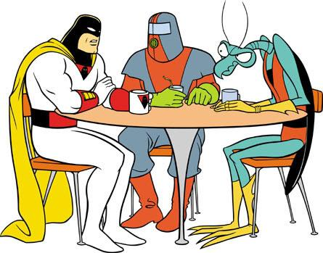
Development
Proposed Work Summary:
Character and Character Function Design
General rules of game
User Interface Design
Story Developing
Environment Design
Sound Design
Technologies:
Unity
Visual Studio / Eclipse
Blender
Adobe Photoshop

Slide 6
Image provided by:
Audience
http://3.bp.blogspot.com/-VEBZokM6daY/TfuTFQwEG8I/AAAAAAAAAoU/3lO9PR6kUMk/s1600/evolution.png
Castle Crasher:
http://www.ign.com/boards/threads/any-games-out-there-similar-to-castle-crashers.454703573/
Don’t Starve Together:
http://riotpixels.net/wp/wp-content/uploads/2016/05/logo-dont-starve-together-review-1.jpg
Icons:
https://openclipart.org/image/800px/svg_to_png/227918/Video-Game-Controller-Icon.png
https://cdn0.iconfinder.com/data/icons/business-seo/512/Search_Group-512.png
http://www.freeiconspng.com/free-images/gear-icon-34314
http://ghpca.org/wp-content/uploads/2016/07/Space-Ghost-tv-03.jpg

